Slide 1
Chapter 3 Genetic Polymorphism

Slide 2
Activity 1: Mutations and Environment
What are the different types of mutations?
Chromosomal mutation (Chapter 5)
Gene mutation

Slide 3
Gene mutation:
Definition: is the accidental changes of DNA (nucleotide sequence) that may lead or not to change in phenotype. Note: new allele is called mutant allele.
Causes:
Spontaneous mutation: due to error in natural biological process such as DNA replication
Induced mutation: due to environmental factors that causes mutations (called mutagens)
UV radiation- polycyclic aromatic hydrocarbons (PAH)- free radicals- smoking..

Slide 4
Transmission and impact of mutation
Are all mutations could be transmitted to off springs?
The transmission of a mutation depends on the type of cell where mutation had occurred.
Somatic cells: mutation can not be transmitted to off springs
Germline sex cells: mutation can be transmitted to off springs.
Why mutations in somatic cells may be significant although they are not transmitted to offspring?
Mutations in somatic cells may develop cancers such as cancer in respiratory system (due to PAH), skin cancer due to UV radiations…

Slide 5
Consequence of mutation
Consequence of mutation: Are all mutations harmful?
Mutation can be:
Harmful: lead to new disease. Example: thalassemia
Favorable: mutations lead to new allele that results in new favorable phenotype. This cause diversity of living things (example dark moth)
Silent: change in DNA that has no change in phenotype

Slide 6
Document 2: Mutations and multiple alleles
Revision:
Relation between gene and phenotype:
DNA (gene) → protein → phenotype
normal allele → normal protein → normal phenotype
Mutant allele → altered protein → altered phenotype

Slide 7
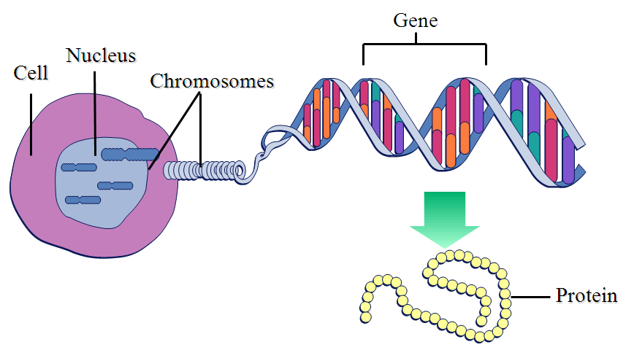
What is a gene?
Genotype
Phenotype

Slide 8
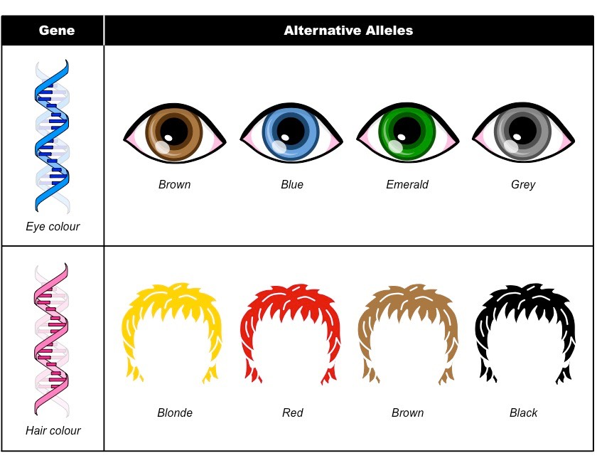
Gene
Phenotype
Gene 1 responsible for the eye color
Hadi Salam Jinan Ahmed
Gene 2 responsible for the hair color

Slide 9
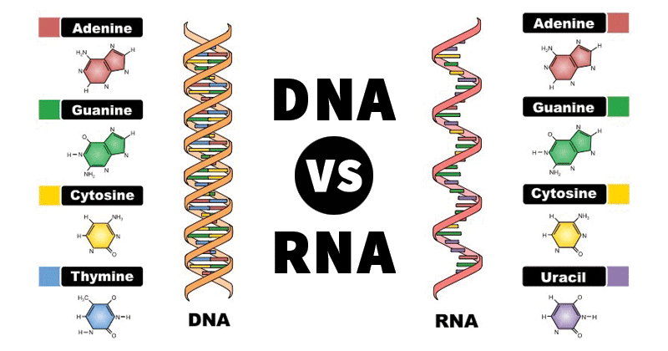

Slide 10
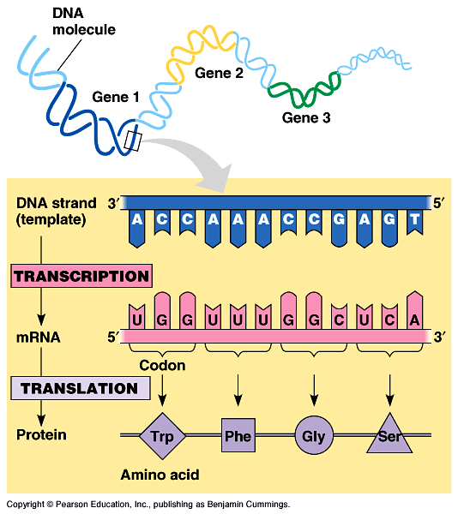
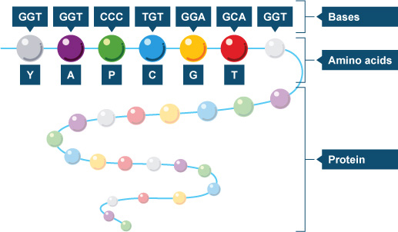
A gene is a fragment of DNA that is responsible for a given trait.
It codes for a specific protein (amino-acid sequence).

Slide 11
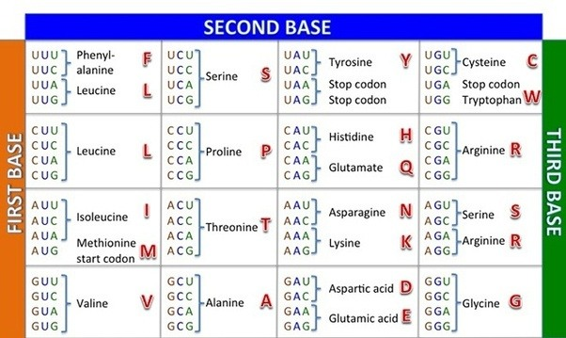
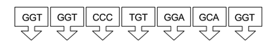
Let us find out the amino acid sequence coded by the below non-transcribed DNA sequence.

Slide 12
DNA protein synthesis
Transcribed Strand
Template
Non-coding
Used in protein synthesis
Double Stranded DNA
Triplet
G A A T T T A T G C C C G
C T T A A A T A C G G G C
Non- Transcribed Strand
Non- Template
coding
Not used in protein synthesis
Transcription
Code
C U U A A A U A C G G G C
mRNA
Complemtanry to transcribed
Identical to non transcribed but T replaced with U
Translation
Leu__ lys __ tyr __ Gly
Note: when writing an aminoacid sequence of polypeptide don’t forget to draw the peptide bond between each 2 consecutive a.a
Polypeptide

Slide 13
Remarks regarding protein synthesis
Remarks:
RNA contains uracil (U) instead of thymine (T)
Stop codons: UAA /UAU/ UAG where translation stops
Change in DNA leads to change in mRNA that leads to change in amino acid sequence and thus change in 3d structure of protein leading to a new phenotype.

Slide 14
Diagram showing relation between gene and phenotype in normal and mutated gene
mutation
Normal DNA of gene
mutant DNA of gene
Normal mRNA
mutant mRNA
Normal protein (functional)
altered protein (functional)
Normal phenotype
abnormal phenotype

Slide 15
Consequences of different types of mutations
Substitution mutations are point mutations that affect one nucleotide thus may lead or not to a change in the sequence of 1 amino acid.
Addition (insertion) or deletion mutations are frameshift mutations disturb the DNA reading frame, so it changes the whole sequence after the mutation

Slide 16
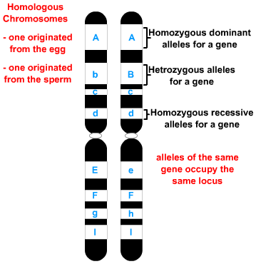
I get one copy of a homologous chromosome from father and one copy of homologous chromosome from mother.
Do my father and mother always share the same genes? Why?
Do my father and mother always share the same traits? Why?
Homologous Chromosomes are chromosomes that carry same genes but may carry different alleles.

Slide 17
Gene 1
Gene 1
Gene 2
Gene 2
Gene 3
Gene 3
Gene 4
Gene 4
Gene 5
Gene 5
Gene 6
Gene
Alleles
Genotype
Gene 6
Gene 7
Gene 7
Gene 8
Gene 8

Slide 18
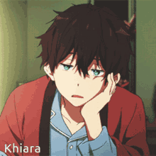
Case Study: Samir and his alleles
Samir is an active boy who is lately feeling thirsty all the time
and urinating frequently.
Although he eats well, he feels that he is always hungry.
You can see him sitting in the playground and when you ask him to play with you, he says that he is too tired even if he is not doing anything.
His doctor suspects that Samir has diabetes; a disease characterized by hyperglycemia due to the presence of abnormal insulin.
So, he asked Samir to do a genetic and molecular test for his insulin hormones.
The results of the test are shown on the next slide.

Slide 19
Compare the results of Samir's insulin molecule to the normal one.
Amino acid sequence of the β chain of the normal insulin molecule. | Phe -Val - Asn - Gln - His - Leu – Cys – Gly – Ser – His - Leu 1 2 3 4 5 6 7 8 9 10 11
Amino acid sequence of the β chain of the Samir's insulin molecule. | Phe -Val - Asn - Gln - His - Leu - Cys - Gly - Ser - Asp - Leu 1 2 3 4 5 6 7 8 9 10 11
2. Formulate a hypothesis about the origin of Samir's disease?

Slide 20
Normal Allele: DNA sequence of normal insulin gene. | AAA -CAC-TTG-GTT-GTG-GAC-TTC-CCC-TCG-GTG-GAG 1 2 3 4 5 6 7 8 9 10 11
Amino acid sequence of the β chain of the normal insulin molecule. | Phe -Val - Asn - Gln - His - Leu – Cys – Gly – Ser – His - Leu 1 2 3 4 5 6 7 8 9 10 11
DNA sequence of Samir's insulin gene. | AAA-CAC-TTG-GTT-GTG-GAC-TTC-CCC-TCG-CTG-GAG 1 2 3 4 5 6 7 8 9 10 11
Abnormal Allele/ Allele of the disease: Amino acid sequence of the β chain of the Samir's insulin molecule. | Phe -Val - Asn - Gln - His - Leu – Cys – Gly – Ser – Asp - Leu 1 2 3 4 5 6 7 8 9 10 11

Slide 21
Normal sentence (Normal DNA) | THE BIG CAT ATE THE FAT RAT.
Modified sentence (Mutant DNA 1) | THE BOG CAT ATE THE FAT RAT.
Modified sentence (Mutant DNA 2) | THE BIC ATA TET HEF ATR AT..
Modified sentence (Mutant DNA 3) | THE BIG CAR TAT ETH EFA TRA T..
Modified sentence (Mutant DNA 4) | THE BIG CAT EAT THE FAT RAT.
Substitution mutation
Deletion mutation
Insertion mutation
Substitution mutation

Slide 22
Types of genetic mutation
G A A T T C
G A A T T C
G A A T T C
C T T A A G
C T T A A G
C T T A A G
Deletion
addition
substitution
G A T T C
G A G A T T C
G A C T T C
C T A A G
C T C A A A G
C T G A A G

Slide 23
Mutations
Point Mutation
Missense
Mutation
Nonsense Mutation
Silent Mutation
Insertion Mutation
Deletion Mutation
Substitution Mutation
Frameshift

Slide 24
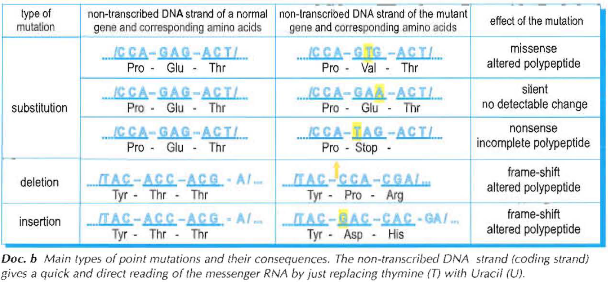
Types of Mutations

Slide 25
Consequences of different types of mutations
Type of mutation | Normal | Mutant | Consequence
 | DNA producing aminoacid | DNA producing aminoacid
Substitution | CCA GAG ACT | CCA GTG ACT | Missnese mutation
 | Pro __ Glu__Thr | Pro __val__Thr
 | CCA GAG ACT | CCA GAC ACT | Silent mutation
 | Pro __ Glu__Thr | Pro __ Glu__Thr
 | CCA GAG ACT | CCA TAG ACT | Non-sense mutation
 | Pro __ Glu__Thr | Pro stop
deletion | TAC ACC ACG A.. | TAC CCA CGA.. | Frame shift mutation
 | Tyr __ Glu __ Thr | Tyr__pro_Arg
insertion | TAC ACC ACG A.. | TAC GAC CAC GA.. | Frame shift mutation
 | Tyr __ Glu __ Thr | Tyr__ Asp__ His

Slide 26

Video About Mutation

Slide 27
Genes and multiple alleles
An example of multiple alleles in humans is ABO blood group.
3 different molecules (A, B, o).
Each molecule is made up of: substance H with presence or absence different type of sugar.
Antigen A: substance H + N-acetyl galactosamine
Antigen B: substance H + galactose
Antigen o: substance H
The type of sugar motif added depends on the type of transferase enzyme present.
Different enzymes are due to presence of different alleles as result of different types of mutations occurred from wild type allele

Slide 28
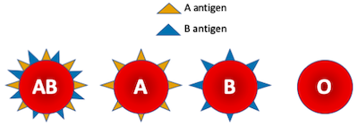
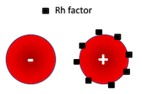
Gene
ABO blood group
Alleles
Allele A
Allele B
Allele o
Gene
Rhesus Group
Alleles
Allele RH+
Allele rh-
An allele is one of several alternative forms of a gene occupying a given locus on a chromosome.

Slide 29
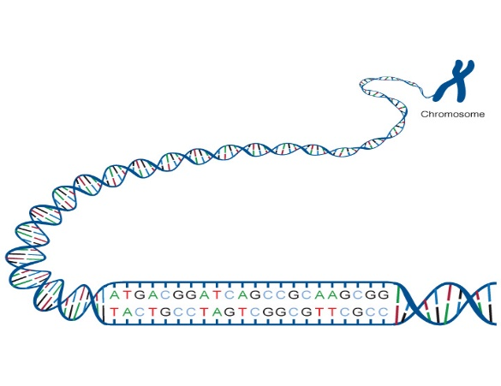
Let us consider the ABO system
Non-transcribed DNA sequence | Allele
GAG – GTG – CGC/…./ CCC – GGC – TTC 235 | Allele A
GAG – GTG – GGC/…./CCC – AGC – TTC 235 | Allele B
Gene of blood group
How are these alleles different in structure?
How are they different in function?
Non-transcribed DNA sequence | Allele
GTG – GTG – ACC – CCT - T | Allele A
GTG – GTG – ACC – CCT - T | Allele B
GTG – GT – ACC – CCT - T | Allele O

Slide 30
Draw out the definition of genetic polymorphism and its possible causes.
Gene is polymorphic when it has more than 2 alleles. The diversity of alleles are due to mutations.

Slide 31
Document 4: Detection of Genetic Polymorphism
Introduction:
As defined in previous document, genetic polymorphism is the presence of 2 or more alleles of the same gene.
And we’ve seen that the origin of different alleles is mutation and thus having different sequences of nucleotides in a given locus
So how can we detect the existence of change in nucleotide sequence?
This can be achieved by the “biological scissors” that are the restriction enzymes

Slide 32
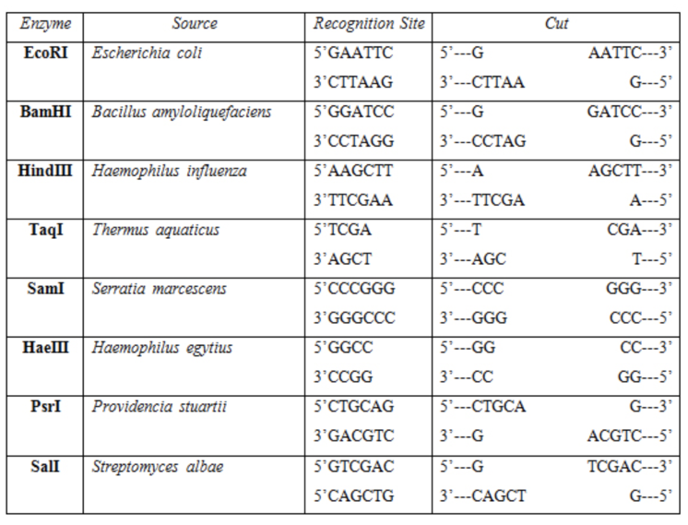
Restriction Enzymes
Restriction enzymes:
Bacterial enzymes
Recognize specific nucleotide sequence (recognition site)
Cuts a specific location in it (cleavage site)
Different enzymes may have different recognition and cleavage sites.

Slide 33
Restriction Enzymes
Example: Given the following sequences of 2 different alleles of same gene
Allele 1:……GGCCTGTGACAGT…..TGACGGCCTGAG….GGCCTG…G
Allele 2:……GGCCTGTGACAGT…..TGACGGCCTGAG….GGCCTG…G
By referring to the previous table, calculate the number of fragments and their length produced by cutting these alleles using Hae III.
1
147
513
750
870
1
147
513
750
870

Slide 34
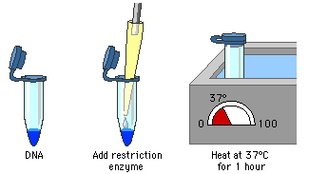
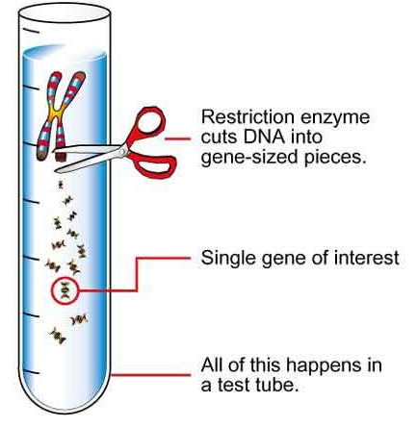
Restriction Enzymes
The restriction process, and the obtained fragments are obtained in a test tube, so how can we detect these fragments?

Slide 35
Gel Electrophoresis
How can we detect these fragments?
By Gel Electrophoresis
Principle:
DNA is –ve charged due to phosphate group
During electrophoresis bands migrate from –ve pole to +ve pole
Migration depends on size: smaller fragments migrates further
Role of Ethidium Bromide (Et-Br)
Dye that binds to DNA and fluoresces under UV light.
Restriction map: is the generated pattern of bands
-
migration
+

Slide 36
Application 1: Given the following sequences of 2 different alleles of same gene
Allele 1:……GGCCTGAATTCGT…..TGACGGCCT Allele 2:……GGCCTGAATTCGT…..TGACGGCCT
By referring to the table of restriction enzymes, compare the action of Hae III and Eco RI on the 2 different alleles.
Deduce the enzyme that is able to detect the genetic polymorphism in this gene.
1
147
513
1
147
513

Slide 37
Application 2:
Two restriction enzymes (Eco RI and Bam HI) were used to cut a piece of DNA. The results are represented in the document below.
Draw restriction map showing the restriction sites of these 2 enzymes
Eco RI + Bam HI
Control
Eco RI
Bam HI
100
200
300
400
500
600
700

Slide 38
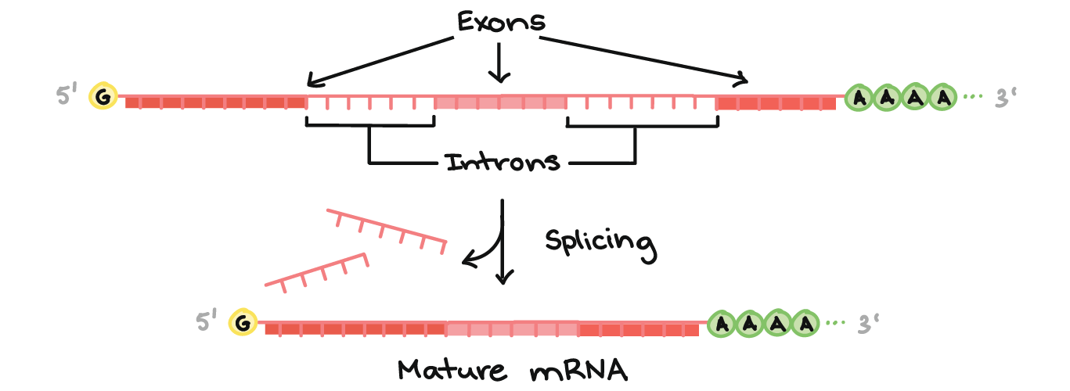
Restriction Fragment Length Polymorphism (RFLP)
Introduction: There are different non-coding regions within chromosome:
Introns are non coding region within the same gene (see adjacent figure)
Telomeres (at the end of chromosome)
Satellites (microsatellites are the part that are usually used in DNA fingerprinting)
Gene regulatory sequences.

Slide 39
Restriction Fragment Length Polymorphism (RFLP)
Mutations in coding regions usually affect phenotype so genetic polymorphism of coding region may be detected through phenotypic variations in a population, but mutations in non-coding regions do not affect phenotype
How can we detect genetic polymorphism in non- coding regions?
This can be achieved through restriction fragment length polymorphism (RFLP)

Slide 40
Restriction Fragment Length Polymorphism (RFLP)
Objective of technique: Detect genetic polymorphism even in non-coding regions which may be used for genetic identity for individuals.
Changes in non-coding regions doesn’t alter the phenotype but changes the restriction map, so restriction map is independent of gene function
DNA fingerprinting (document 5) is an application of RFLP technique

Slide 41
Document 5: Genetic Identity of individual
Introduction:
Because of the large number of polymorphisms observed in humans, it is virtually certain that each of us is genetically unique (except identical twins). How can we determine genetic identity of individual?

Slide 42
General terms
Probe: a known sequence of radioactive or fluorescent DNA used to hybridize the denatured DNA molecule by complementarity
Denaturing: separation of DNA strands by high temperature or using NaOH
Hybridization: binding of probe to studied bands/ gene by complementarity.
Blotting: transferring

Slide 43
DNA Fingerprinting
DNA fingerprinting is an application of RFLP and it is used for:
Paternity Test
Forensic science (crimes, victims after plane crush..)
Steps: (see adjacent figure) paragraph 3 + doc. c p:68
Probe used is multi-locus (complementary to sequence occurs frequently throughout the genome)
Solve exercise IV + V p: 73

Slide 44
Exercise IV
The DNA isolated from blood traces left at the scene of the crime and the DNA of the suspect are cut with the same restriction enzyme, electrophoresed and blotted onto a membrane. The membrane is then hybridized to a ³²P labelled probe which is complementary to a repetitive sequence. The two DNA fingerprints are compared. If the two patterns are identical, then one can safely conclude that the traces of the blood at the scene of the crime are those of the suspect.

Slide 45
Exercise V
No since every band of the child’s DNA finger print is present either in the mother or the father’s DNA fingerprint so the child belong to this couple.

Slide 46
DNA fingerprinting in paternity test
Each band of child’s DNA fingerprint should be shared with either the father’s or the mother’s DNA fingerprint.

Slide 47
Fluorescent In Situ Hybridization (FISH)
Aim:
Locate locus of gene on metaphasic chromosome using fluorescent probe
Detect chromosomal mutations (deletion, translocation..)
Detect certain types of viral infection
Steps:
Denaturation of DNA
Hybridization: add monolocus probe
Observation: The chromosome shows a fluorescent dot where the studied gene (or sequence of interest) is located.
FISH technique and other mapping techqniques allowed to construct genetic maps

Slide 48
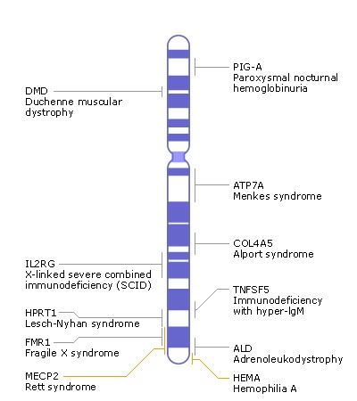
Genetic Map
Genetic map representation of arrangement of genes on chromosome
It can be constructed by using many different mono-locus probes
Chromosome X genetic map

